Slide 1

SWD 392 - Software Architecture and Design

Slide 2
SWD392 Dynamic Interaction Modeling
Here is where your presentation begins

Slide 3
Introduction
Describes dynamic interaction modeling concepts. Interaction (sequence or communication) diagrams are developed for each use case, including the main scenario and alternative scenarios.
It also describes how to develop an interaction model starting from the use case.

Slide 4
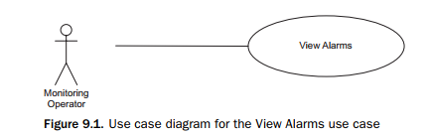
Dynamic modeling provides a view of a system in which control and sequencing are considered, either within an object (by means of a finite state machine) or between objects (by analysis of object interactions).
Dynamic interaction modeling is based on the realization of the use cases developed during use case modeling.
This chapter describes stateless dynamic interaction modeling, also referred to as basic dynamic interaction modeling.

Slide 5
Table of contents
01
OBJECT INTERACTION MODELING
02
MESSAGE SEQUENCE NUMBERING ON INTERACTION DIAGRAMS
03
DYNAMIC INTERACTION MODELING
04
STATELESS DYNAMIC INTERACTION MODELING
05
EXAMPLES OF STATELESS DYNAMIC INTERACTION MODELING

Slide 6
01
OBJECT INTERACTION MODELING

Slide 7
9.1 OBJECT INTERACTION MODELING
For each use case, the objects that realize the use case dynamically cooperate with each other and are depicted on either a UML communication diagram or a UML sequence diagram.
9.1.1 Communication Diagrams
A communication diagram is a UML interaction diagram that depicts a dynamic view of a group of objects interacting with each other by showing the sequence of messages passed among them.
On a communication diagram, the sequence in which the objects participate in each use case is depicted by means of message sequence numbers.
The communication diagram for this use case depicts the user interaction object, Operator Interaction, making a request to the service object, Alarm Service and receiving a response (see Figure)

Slide 8
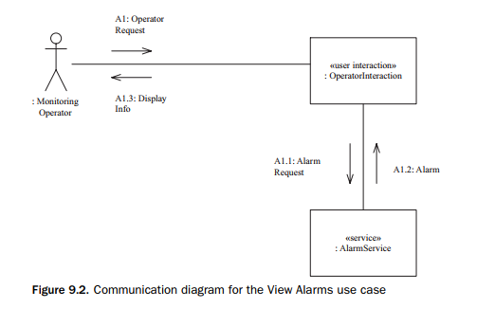

Slide 9
9.1.2 Sequence Diagrams
The interaction among objects can also be shown on a sequence diagram.
A sequence diagram shows the objects participating in the interaction and the sequence in which messages are sent.
Sequence diagrams can also depict loops and iterations.
Sequence diagrams and communication diagrams depict similar (although not necessarily identical) information, but in different ways.
In the following example, however, the messages on the sequence diagram are numbered to show their correspondence to the communication diagram.
An example of a sequence diagram for the View Alarms use case is shown in Figure 9.3. This sequence diagram conveys the same information as the communication diagram shown in Figure 9.2.

Slide 10
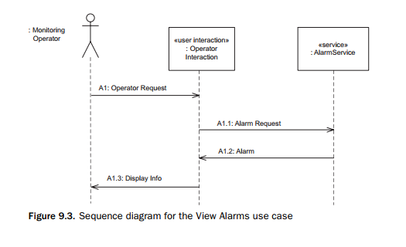

Slide 11
9.1.3 Analysis and Design Decisions in Object Interaction Modeling
In the analysis model, messages represent the information passed between objects.
Interaction diagrams (communication diagrams or sequence diagrams) help in determining the operations of the objects because the arrival of a message at an object usually invokes an operation.
In COMET, however, the emphasis during analysis modeling is on capturing the information passed between objects, rather than on the operations invoked.
The kind of message passed between objects – synchronous or asynchronous – is a design decision that is also postponed to the design phase.

Slide 12
9.1.4 Sequence Diagram versus Communication Diagram
Either a sequence diagram or a communication diagram can be used to depict the object interaction and sequence of messages passed among objects.
However, using iterations (such as do-while) and decision statements (if-then-else) can obscure the sequence of object interactions.
The communication diagram shows the layout of the objects, particularly how the objects are connected to each other.
The COMET preference is to use communication diagrams rather than sequence diagrams, because an important step in the transition to design is the integration o the communication diagrams to create the initial software architecture of the system

Slide 13
9.1.5 Use Cases and Scenarios
A scenario is one specific path through a use case.
To show all the alternatives through a use case, development of more than one interaction diagram is often necessary.
However, such comprehensive interaction diagrams are usually more difficult to read. In practice, depicting an individual scenario on an interaction diagram is usually clearer.

Slide 14
9.1.6 Generic and Instance Forms of Interaction Diagrams
The two forms of an interaction (sequence or communication) diagram are the generic form and the instance form.
- The instance form describes a specific scenario in detail, depicting one possible sequence of interactions among object instances.
- The generic form describes all possible interactions in which the objects might participate, and so can include loops, branches, and conditions.
For all but the simplest use cases, an interaction diagram is usually much clearer when it depicts an instance form rather than a generic form of interaction.

Slide 15
02
MESSAGE SEQUENCE NUMBERING ON INTERACTION DIAGRAMS

Slide 16
9.2 MESSAGE SEQUENCE NUMBERING ON INTERACTION DIAGRAMS
Messages on a communication diagram or sequence diagram are given message sequence numbers.
9.2.1 Message Labels on Interaction Diagrams
A message label on a communication or sequence diagram has the following syntax.
[sequence expression]: Message Name (argument list)
where the sequence expression consists of the message sequence number and an indicator of recurrence.
Message sequence number: The first message sequence number represents the event that initiates the message sequence depicted on the communication diagram.

Slide 17
Recurrence: The recurrence term is optional and represents conditional or iterative execution
1: ∗ [iteration-clause]. An asterisk (∗) is added after the message sequence number to indicate that more than one message is sent 2: [condition-clause]. A condition is specified in square brackets to indicate a branch condition.
Message name. The message name is specified.
Argument list. The argument list of the message is optional and specifies any parameters sent as part of the message.

Slide 18
9.2.2 Message Sequence Numbering on Interaction Diagrams
On a communication diagram supporting a use case, the sequence in which the objects participate in each use case is described and depicted by message sequence numbers.
A message sequence number for a use case takes the following form:
[first optional letter sequence] [numeric sequence] [second optional letter sequence]
The first optional letter sequence is an optional use case ID and identifies a specific concrete use case or abstract use case.
The simplest form of message sequencing is to use a sequence of whole numbers, such as M1, M2, and M3.

Slide 19
9.2.3 Concurrent and Alternative Message Sequences
The second optional letter sequence is used to depict special cases of branches –either concurrent or alternative – in the message sequence numbering.
Concurrent message sequences may also be depicted on a communication diagram.
Alternative message sequences are depicted with the condition indicated after the message. An uppercase letter is used to name the alternative branch.
- For example, the main branch may be labeled 1.4[Normal], and the other 1.4A[Error].
-The message sequence numbers for the normal branch would be 1.4[Normal], 1.5, 1.6, and so on. The message sequence numbers for the alternative branch would be 1.4A[Error], 1.4A.1, 1.4A.2, and so on

Slide 20
9.2.4 Message Sequence Description
A message sequence description is supplementary documentation, which is useful to provide with an interaction diagram.
The message sequence description is a narrative description, describing what happens when each message arrives at a destination object depicted on a communication diagram or sequence diagram.
The message sequence description usually provides additional information that is not depicted on the object interaction diagram.
- For example, every time an entity object is accessed, the message sequence description can provide additional information, such as which attributes of the object are referenced.

Slide 21
03
DYNAMIC INTERACTION MODELING

Slide 22
9.3 DYNAMIC INTERACTION MODELING
Dynamic interaction modeling is an iterative strategy to help determine how the analysis model objects interact with each other to support the use cases.
Dynamic interaction modeling is carried out for each use case.
This analysis might show a need for additional objects and/or additional interactions to be defined.
Dynamic interaction modeling can be either state-dependent or stateless, depending on whether the object communication is state-dependent.

Slide 23
03
STATELESS DYNAMIC INTERACTION MODELING

Slide 24
9.4 STATELESS DYNAMIC INTERACTION MODELING
The main steps in the stateless dynamic interaction modeling approach are as follows, starting with the use case.
1. Develop use case model.
2. Determine objects needed to realize use case.
2a. Determine boundary object(s).
2b. Determine internal software objects.
3. Determine message communication sequence. 4. Determine alternative sequences.

Slide 25
04
EXAMPLES OF STATELESS DYNAMIC INTERACTION MODELING

Slide 26
9.5 EXAMPLES OF STATELESS DYNAMIC INTERACTION MODELING
Two examples are given of stateless dynamic interaction modeling. The first example starts with the use case for View Alarms, and the second example starts with the use case for Process Delivery Order
9.5.1 View Alarms Example
As an example of stateless dynamic interaction modeling, consider View Alarms use case from the Emergency Monitoring System case study.
1. Develop Use Case Model
The use case description is briefly described as follows:
Use case name: View Alarms Actor: Monitoring Operator Summary: The monitoring operator views outstanding alarms and acknowledges that the cause of an alarm is being addressed. Precondition: The monitoring operator is logged in.
Main sequence: 1. The Monitoring Operator requests to view the outstanding alarms. 2. The system displays the outstanding alarms. For each alarm, the system displays the name of the alarm, alarm description, location of alarm, and severity of alarm (high, medium, low). Postcondition: Outstanding alarms have been displayed

Slide 27
2. Determine Objects Needed to Realize Use Case
- Because View Alarms is a simple use case, only two objects participate in the use case. 3. Determine Message Communication Sequence
- The communication diagram for this use case depicts the user interaction object, the Operator Interaction object, making a request to the service object, Alarm Service, which responds with the desired information

Slide 28
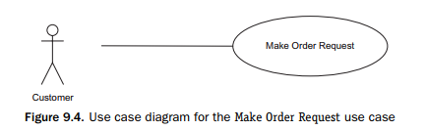
9.5.2 Make Order Request Example
The second example of stateless dynamic interaction modeling is from the online shopping service-oriented system.
1. Develop Use Case Model - In the Make Order Request use case, a customer actor enters the order request information.
- The use case diagram is depicted in Figure 9.4 and the use case description is as follows:

Slide 29
2. Determine Objects Needed to Realize Use Case
As before, the objects needed to realize this use case can be determined by a careful reading of the use case, as shown in bold type.
Given the customer actor, there will need to be a user interaction object, Customer Interaction.
Service objects are needed for the four services needed to realize this use case, Customer Account Service, Credit Card Service, Delivery Order Service, and Email Service.
There will also need to be a coordinator object, Customer Coordinator, to coordinate the interactions between Customer Interaction and the four service objects.

Slide 30
3. Determine Message Communication Sequence
The interaction sequence among the objects needs to reflect the interaction sequence between the actor and the system, as described in the use case.
The use case description (step 1) indicates that the customer requests to create an order.
In step 2 of the use case, the system retrieves the account information.
In step 3 of the use case, the system checks the customer’s credit card.
In step 4 of the use case, the system creates a delivery order.
Next in the use case, the system confirms the order to the user and sends a confirmation email via the email service

Slide 31
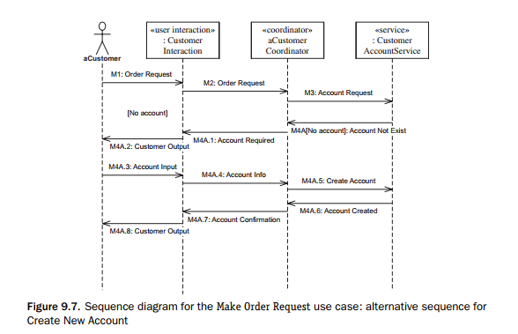
4. Determine Alternative Sequences.
Alternative scenarios for this use case are that the customer does not have an account, in which case a new account will be created, or that the credit card authorization is denied, in which case the customer has the option of selecting a different card.
- The new account alternative scenario is depicted in Figure 9.7.

Slide 32
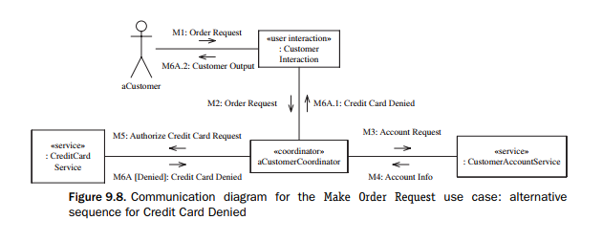
The credit card denied alternative scenario is depicted in Figure 9.8.

Slide 33
Thanks!

